Slide 1
Windows File System – Nov 29
Agenda
Mod A.5 Windows File System
Presentation / Debrief
Start Level 1 Today
Previous Work
Mod B.5 Python File Access
Mod A.4 Binary Numbers (DUE)
Case C.5 SIM Swap Fraud (DUE)
Mod A.3 OS Concept Map (DUE)
Upcoming
Tomorrow: Mod A.5 – Level 2

Slide 2
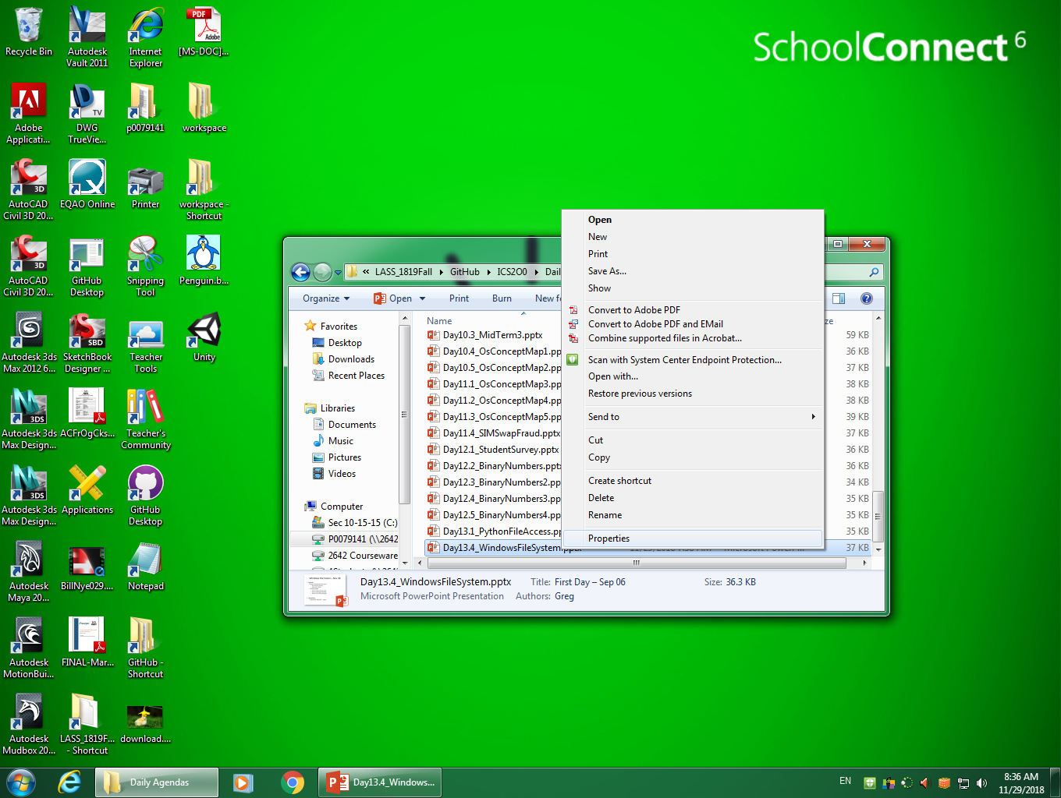

Slide 3
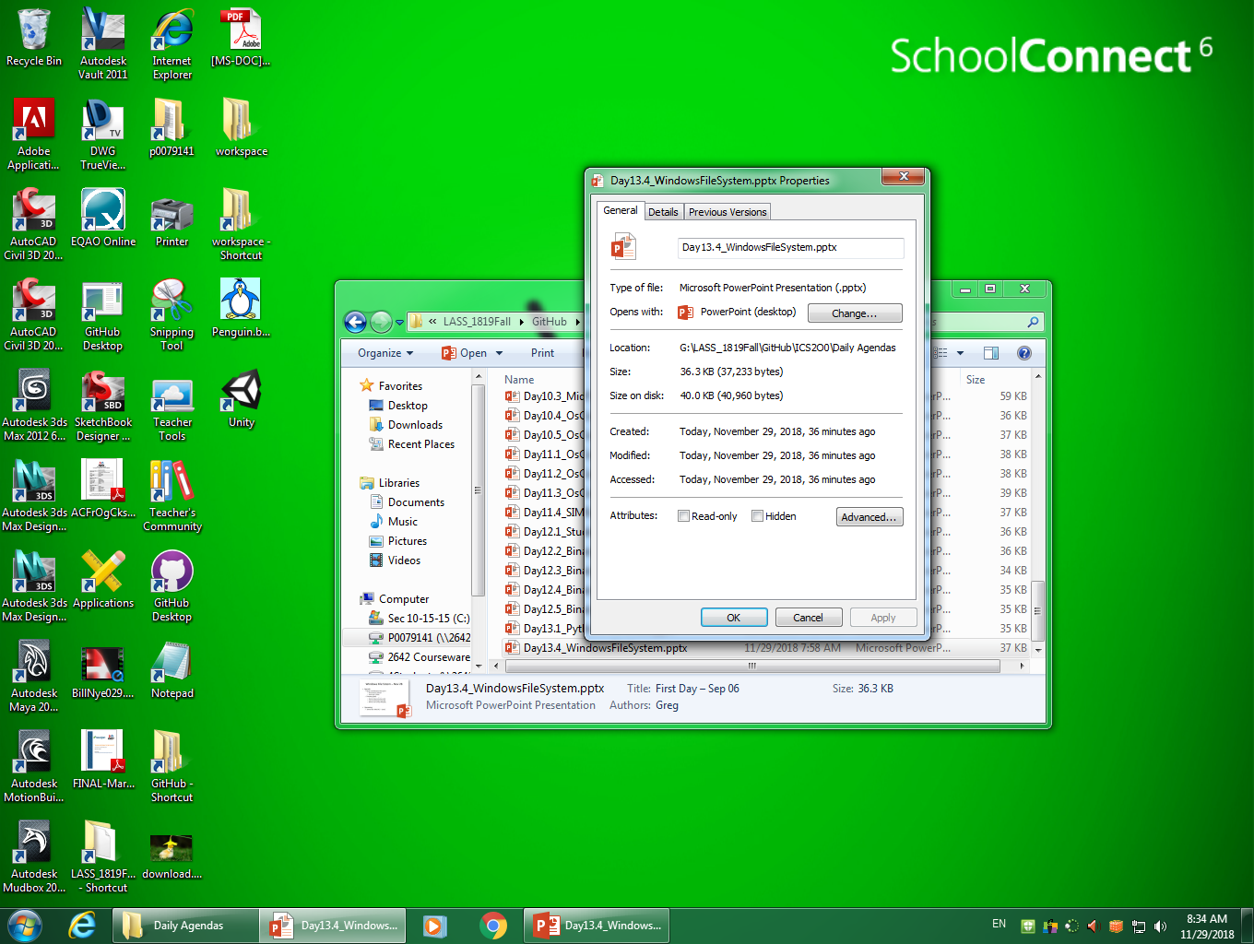

Slide 4
